Slide 1

WELCOME!

Slide 2
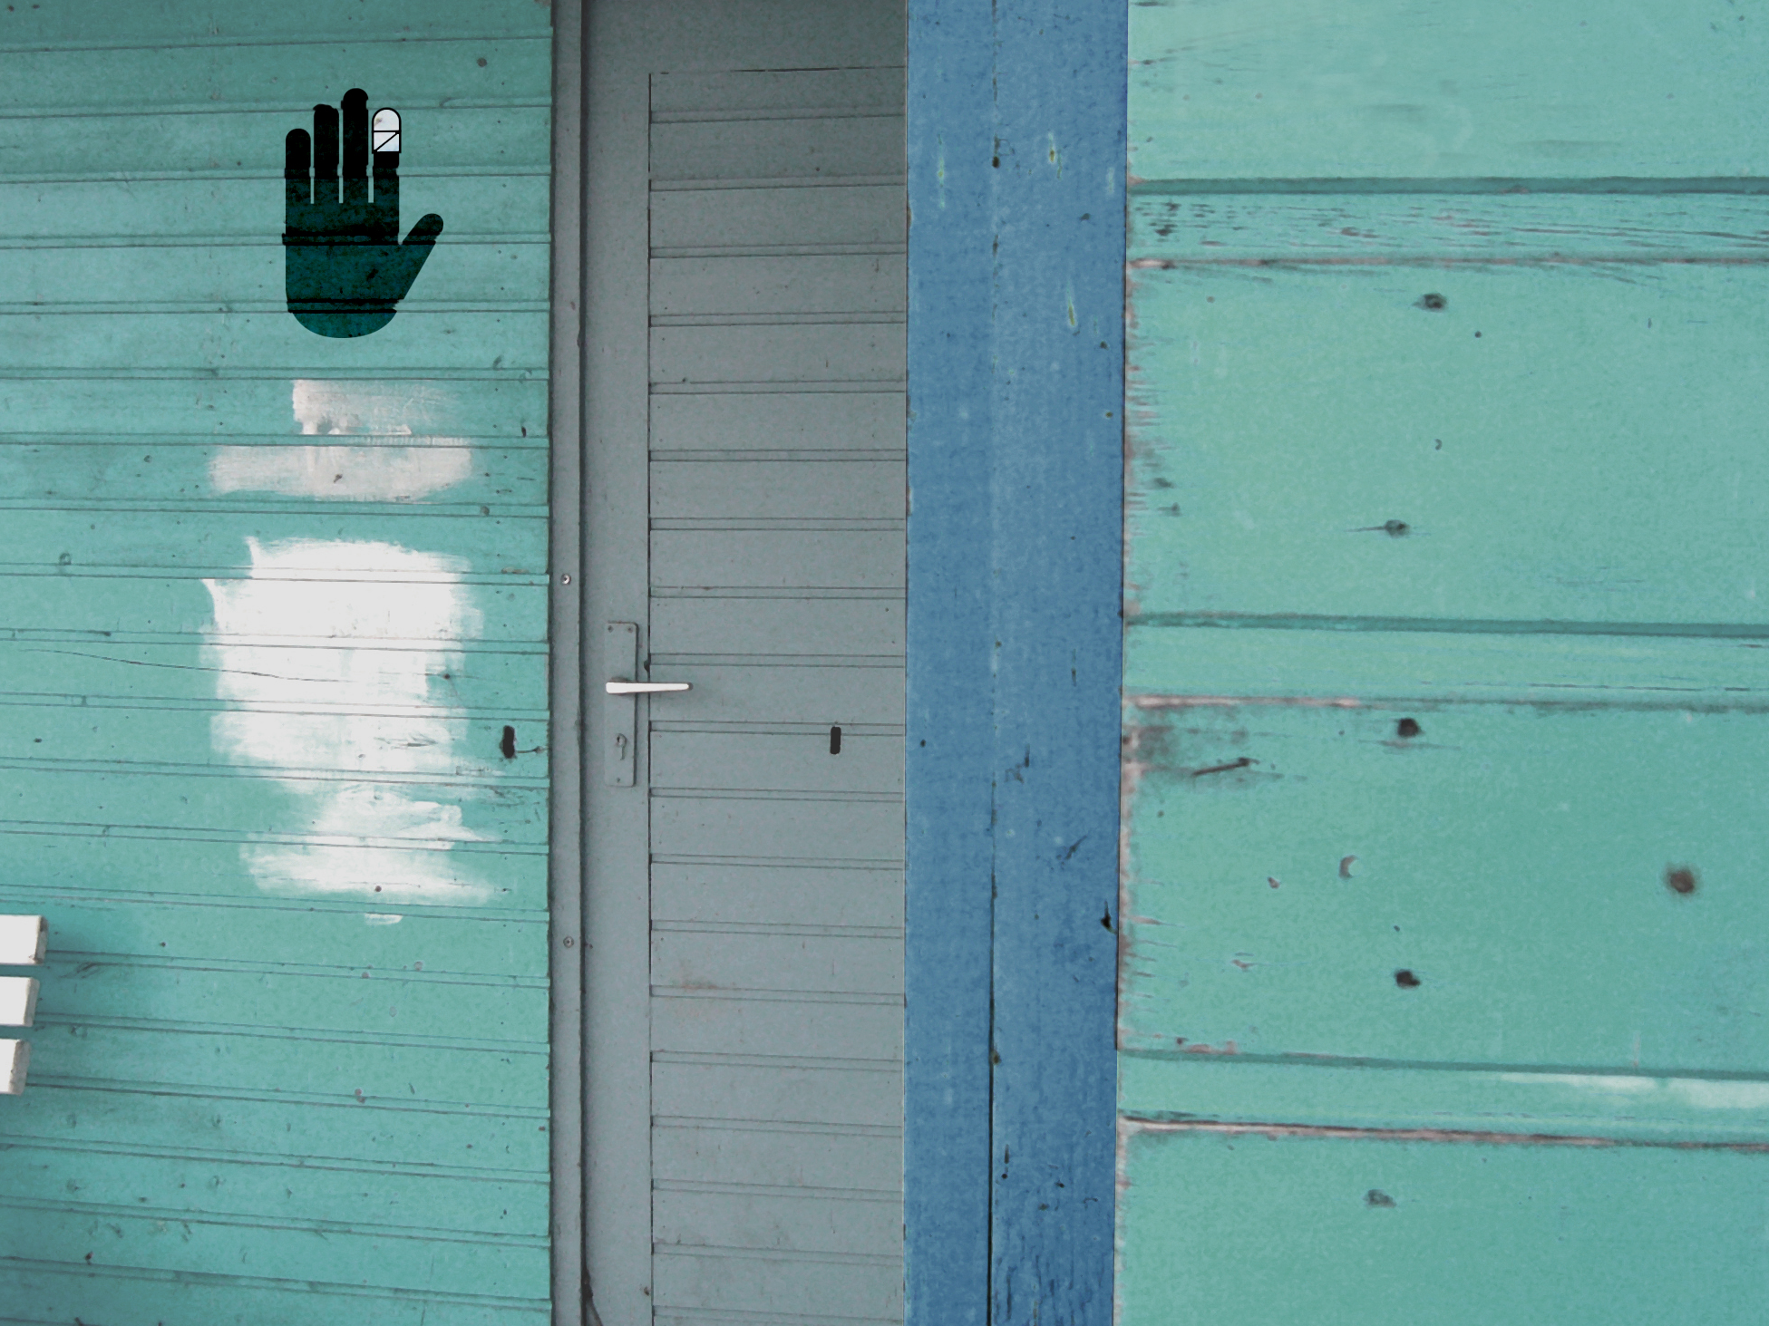
FITH SESSION
BAND-AID

Slide 3

REMINDER:
WHAT ARE WE EXPECTING?
Continuous discussion
Every part closes with a challenge
You will complete your personal MyLife-Map
You will come to new conclusions about your life
Important: Everything is treated confidentially!

Slide 4
WHERE DID YOU
EXPERIENCE PAIN
LAST WEEK?

Slide 5
FLASHBACK.
We have discovered: positive and negative events and people have ”imprinted“ us.

Slide 6
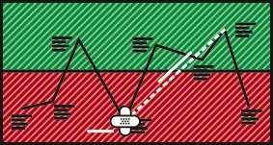
ACTION.
LINES.
On your map find the hightest and the lowest point of ”imprint“ in your life. Draw a line between these milestones, connecting the high with the low.
BAND-AID.
Cross two band-aids over each other under your lowest point.

Slide 7
GOD KNOWS BOTH:
HEIGHTS AND DEPTHS.
His high point is higher than
the best day of your life (we call it ”heaven“).
His low point is more painful than
the worst day of your life (we call it ”hell“).

Slide 8

VIDEO

Slide 9
GoD LEFT HEAVEN (grEEN) AND ENTERED HELL (RED).
JeSUS, WHO IS GOD, LEFT HIS GREEN ZONE IN ORDER TO BOTH DIE AS A CRIMINAL ON THE CROSS AND TO SUFFER HELL.

Slide 10

WHY DID GOD DO THIS?
Because He loves us. He wants your ”shalom“ (inner peace).
He wants us to be free from our failures and debts.
Jesus is called our ”saviour“ in the Bible. This means: He wants to make us whole again. Only Jesus can heal your broken relationship with God.

Slide 11
Surely he took up our pain
and bore our suffering
yet we considered him punished by God,
stricken by him, and afflicted.
But he was pierced for our transgressions,
he was crushed for our iniquities,
the punishment that brought us peace
was on him,
and by his wounds we are healed.

Slide 12
We all, like sheep, have gone astray,
each of us has turned to our own way,
and the Lord has laid on him
the iniquity of us all.
Isaiah 53:4-6

Slide 13
SIN MEANS MISSING
THE GOAL.
How often have we disappointed ourselves? We all fall short of our own standards.
Much more serious is falling short of God´s life-laws for us (for example, the ten commandments), whether it comes from having no interest in God, disregard or rebellion.

Slide 14
But God demonstrates His own love for us in this, while we were still sinners, Christ died for us.
Romans 5:8

Slide 15
Our predicament: If behind our wishes there is longing, what is behind sin?
Behind sin there is mistrust. We have refused to trust God completely.
For this reason, Jesus‘ death on the cross is God‘s bridge to our lives to reconcile us with Himself.
Because:
We are unable to turn back the clock (think about the people we have hurt in the red zones of our lives),
We cannot justify ourselves before God,
We ourselves cannot give ”Shalom“.
For this reason, Jesus died and rose again from the dead – for us!
Simply this: Jesus accomplishes what we could not do in order for us to have peace (”Shalom“) with God, with ourselves and others.
”Jesus lived the life that we should have lived. And he died the death we deserved.“

Slide 16
WHAT DOES THIS
MESSAGE DO TO ME?

Slide 17
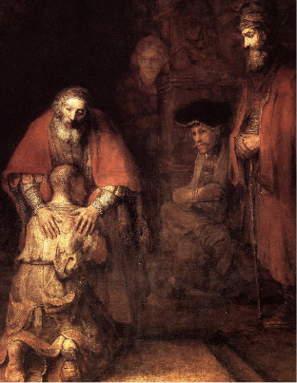
HOMEWORK.
BROTHERS.
Study this picture daily. Imagine yourself in this scene. Which of the brothers are you? What is triggered in you, feeling the Fathers´s accepting hands placed on your shoulders?

Slide 18
HOMEWORK.
PRAYER.
”Jesus Christ, you have come to me at the point of my life’s deepest pain. On a terrible instrument of torture, on the cross, you suffered for me. In your suffering I recognize your love for me.
Till now I have refused to acknowledge you as my God and Savior. I want to change that. I have come to realize that I have failed to trust you. For this I am sorry.
I do not want to live this way anymore. I need you and long for your SHALOM. Therefore, I place my trust in you und ask you to forgive me of my sin. I accept your forgiveness as a precious gift. I desire to follow you and from this time on let you shape me as I do what you want from me. Thank you that I can truly call you the treasure of my life. Amen.“


Slide 19
WHAT IDEA WAS
ESPECIALLY
IMPORTANT TO
YOU TODAY?

Slide 20
SEE YOU NEXT TIME!

Slide 21
www.mylifeworkshop.com
MyLife is a workshop by Dr. Dietrich Schindler
©2015
Kommunikative Gestaltung www.lumen-design.de
Bildnachweis: suze, bit.it – photocase.de
Rembrandt van Rijn

