Slide 1
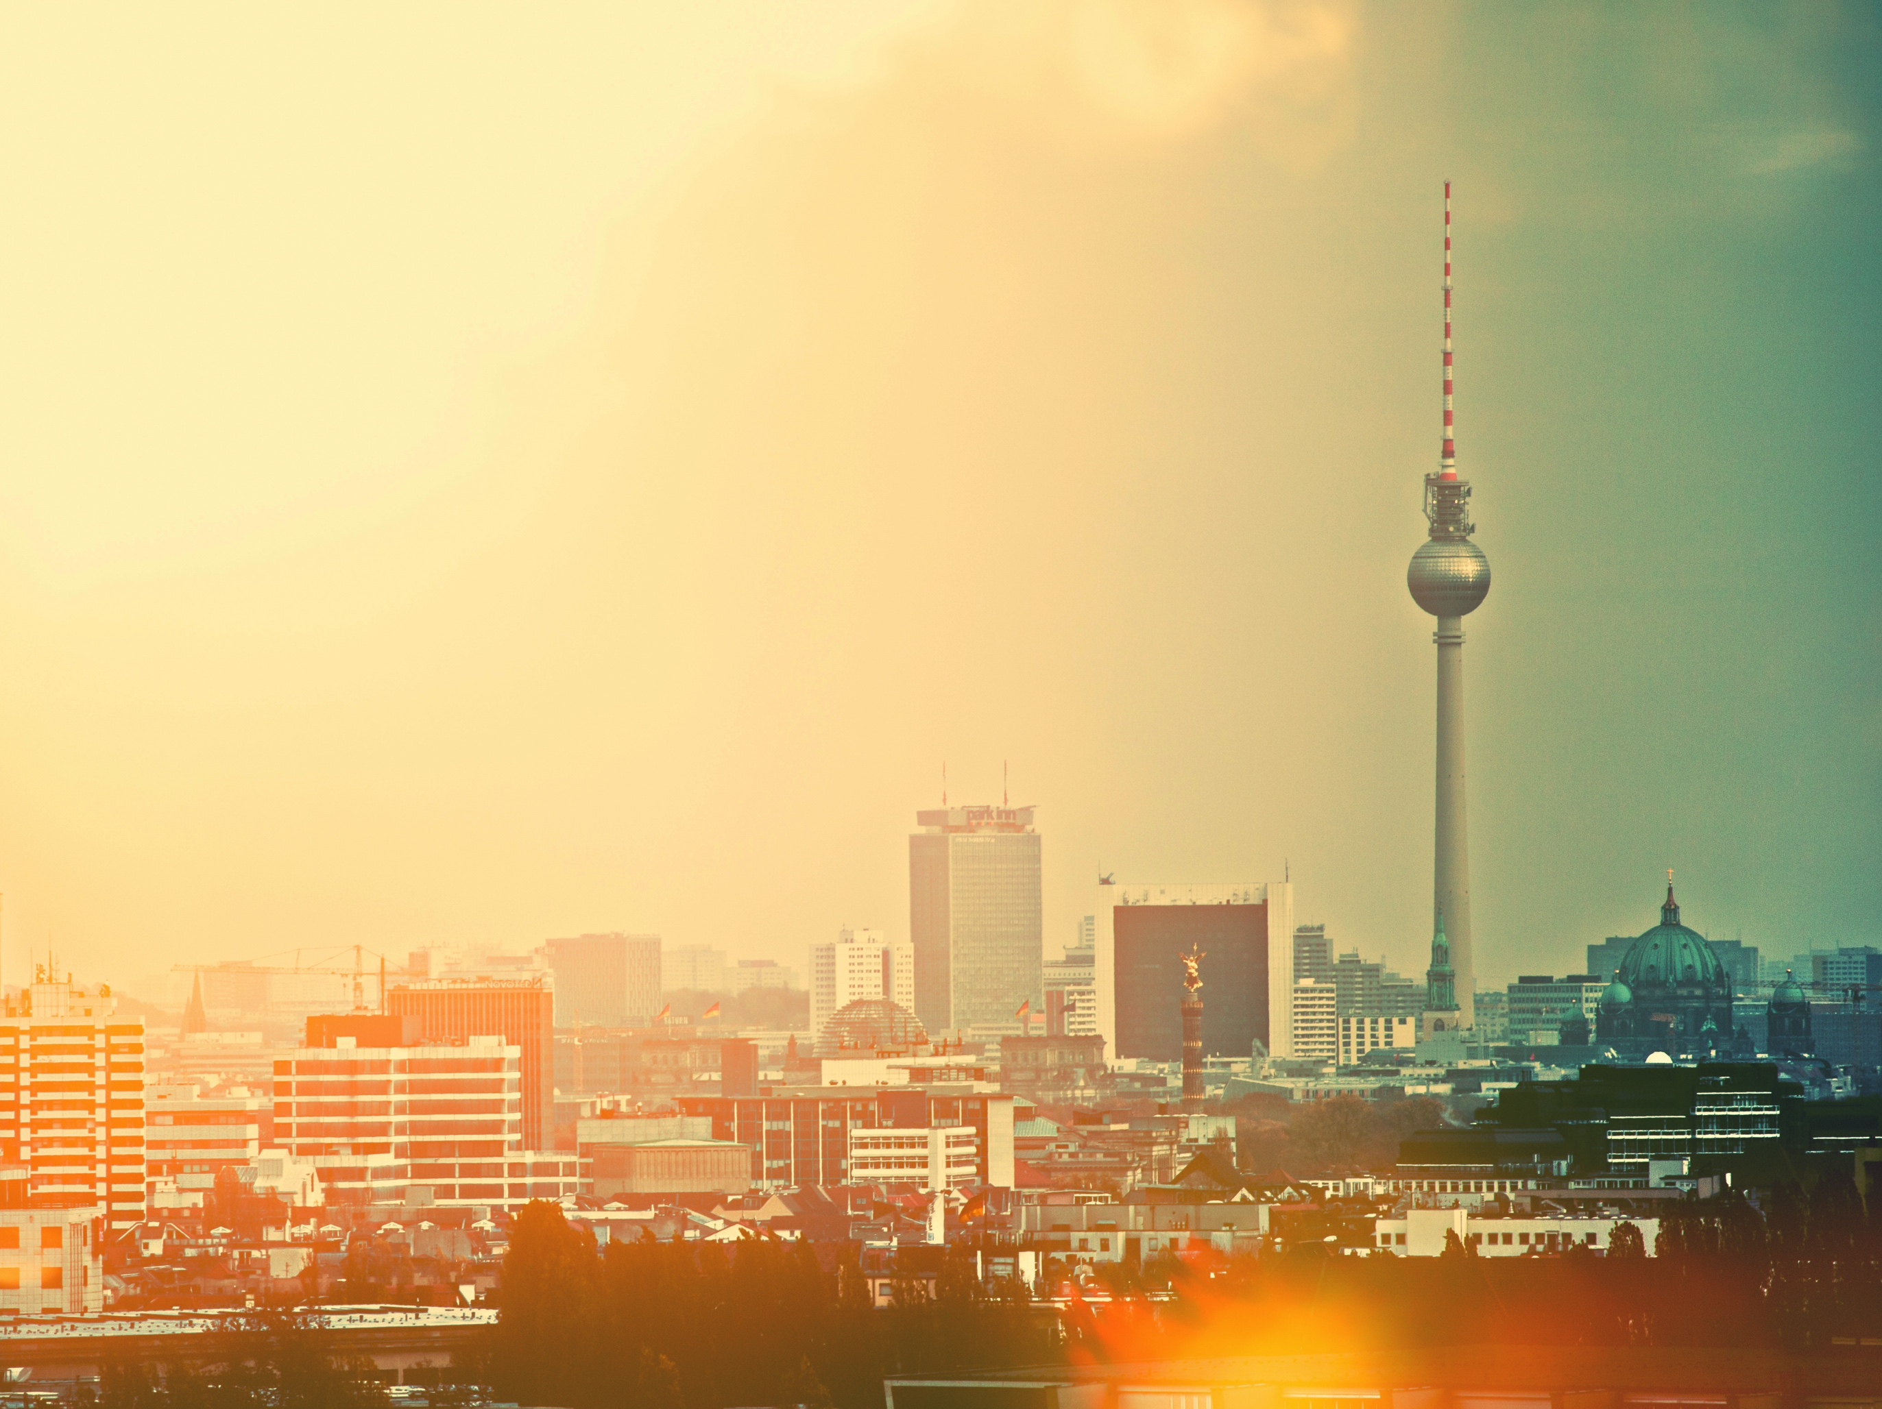
WELCOME!

Slide 2

WARM-UP:
”WHERE DID
YOU EXPERIENCE
A DETOUR
LAST WEEK?“

Slide 3
SHARE:
”AT YOUR FUNERAL: AFTERWARDS
YOU HEAR YOUR FRIENDS TALKING ABOUT YOU.
WHAT DO THEY SAY
WAS THE QUINTESSENCE OF YOUR LIFE?“

Slide 4

FOURTH SESSION
MUSIC

Slide 5
MUSIC
LISTEN TO
THIS LINK
FOR 3-4 MINUTES

Slide 6

THE ”MELODY“
IN YOUR LIFE.
God‘s presence in your life is comparable with a melody in the background, a recurring sound, so to speak.
At times, God‘s presence is loud and at other times, He is hardly heard.
But He is always ”audible“ in your life.

Slide 7
ACTION.
THINK.
Where have you ”heard“ the music of God´s presence in your life?
GOD´S MELODY.
Mark this with music notes on your MyLife-Map.
SHARE.
How and where have you ”heard“ God in your life?

Slide 8
THERE WERE GOOD AND DIFFICULT TIMES IN OUR LIVES WHERE WE HAVE ”HEARD“ GOD EITHER LOUDLY OR MORE SOFTLY.

Slide 9
HOW DID YOU
EXPERIENCE GOD`S
PRESENCE IN
DIFFICULT TIMES?

Slide 10
I CAN REACT AS A DOUBTER AND SAY: GOD, IF YOU REALLY EXIST, AND I`VE HEARD YOU MANY TIMES IN MY LIFE, PlEASE SHOW YOURSELF TO ME.
IF YOUR MELODY IS AN INVTAION FOR ME TO KNOW YOU, I WANT TO GET TO KNOW YOU NOW.

Slide 11
He does this because He wants us to seek Him. We were made to find Him. And He is really very near to each one of us!
”For in Him we live and move and exist;
He is not far from each of us!“
Acts 17:27-28

Slide 12
HOMEWORK.
THINK.
Ask yourself: What does what I've experienced do to me?
ASK.
If you like, ask God directly if He exists.
Ask Him sincerely and simply to show Himself to you through His "melody" in your life.

Slide 13
WHAT IDEA WAS
ESPECIALLY
IMPORTANT TO
YOU TODAY?

Slide 14
SEE YOU NEXT TIME!

Slide 15
www.mylifeworkshop.com
MyLife is a workshop by Dr. Dietrich Schindler
©2015
Kommunikative Gestaltung www.lumen-design.de
Bildnachweis: N.O.B., john krempl, fritz international – photocase.de

