Slide 1

WELCOME!

Slide 2

REMINDER:
WHAT ARE WE EXPECTING?
Continuous discussion
This final part closes with a challenge
You will complete your personal MyLife-Map
You will come to new conclusions about your life
Important: Everything is treated confidentially!

Slide 3
THINK ABOUT
SOMETHING YOU
ONCE FOUND.
WHAT DID IT
MEAN TO YOU?

Slide 4

SIXTH SESSION
TREASURE

Slide 5
Some things are too good to be true – among them discovering a treasure!

Slide 6
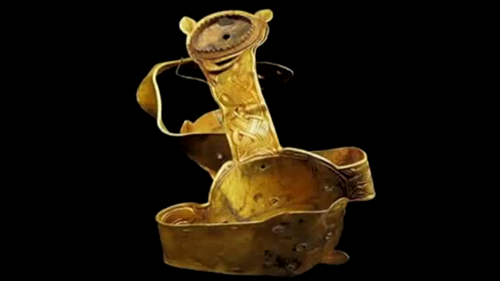

Slide 7
”The kingdom of heaven is like treasure hidden in a field. When a man found it, he hid it again, and then in his joy went and sold all he had and bought that field.
Again, the kingdom of heaven is like a merchant looking for fine pearls. When he found one of great value, he went away and sold everything he had and bought it.“
Matthew 13:44-46

Slide 8
PEOPLE COMMENTING ON THEIR TREASURE
“When people say,
”good teacher“, ”prophet“, ”a nice guy“...
This is not what Jesus claimed about Himself.
So we‘re confronted with a challenge, that is, believing that Jesus is either who He claimed to be or that He was crazy.
But I believe that Jesus was the Son of God.“
Bono, singer in the band U2

Slide 9
PEOPLE COMMENTING ON THEIR TREASURE
“In the end, believing means finally coming home, gleaning the thread of a lost life, the answer to a bell that has been ringing for ages, finally taking your place at an empty table.”
Malcolm Muggeridge,
Journalist, former Communist, philosopher

Slide 10
JESUS & YOU.
„Change and renewal have to begin with me.“
Dietrich Bonhoeffer .
Each one who responds to God‘s invitation through Jesus is like
a treasure hunter who has found the greatest treasure of his life!

Slide 11

LIFE
WITH
JESUS
LIFE
WITHOUT
JESUS
Forgiveness of my sin(s)
God´s acceptance
Shalom ”peace“,
holistic well-being
Debt-ridden life
Separated from God
Strife and agitation

Slide 12
WHERE DO YOU SEE
YOURSELF IN THE
RIGHT-HANDED LIST?
Debt-ridden life
Separated from God
Strife and agitation

Slide 13
WHY DOES IT MAKE
SENSE TO LIVE A
LIFE WITH JESUS?
Forgiveness of my sin(s)
God´s acceptance
Shalom ”peace“
holistic well-being

Slide 14
Jesus invites YOU
to come TO him
to receive
new life in him!

Slide 15
WHAT MUST I DO
TO ACCEPT
HIS OFFER?

Slide 16
Everyone who believes may have eternal life in him.
For God so loved the world that he gave his one and only Son, that whoever believes in him shall not perish but have eternal life.
John 3:15-16

Slide 17
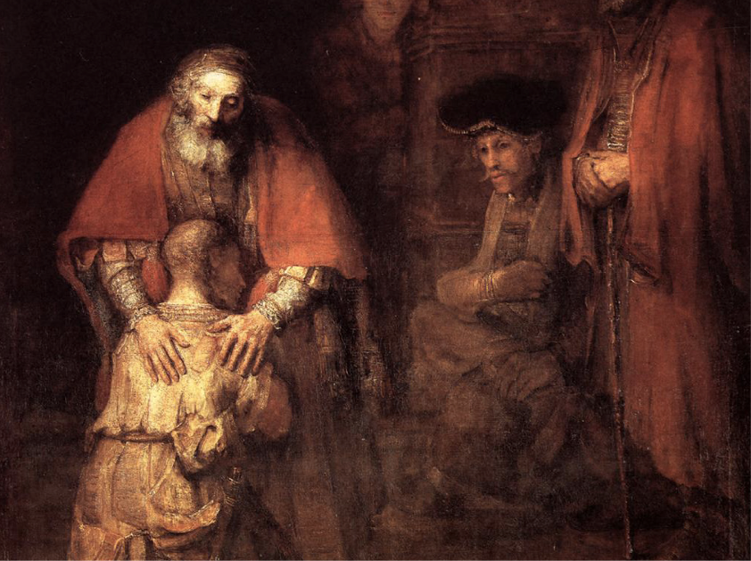
YES,
JESUS,
I WANT
TO COME
HOME!

Slide 18
PRAYER
„Jesus Christ, you have come to me at the point of my life’s deepest pain. On a terrible instrument of torture, on the cross, you suffered for me. In your suffering I recognize your love for me.
Up to now I have refused to acknowledge you as my God and Savior. I want to change that. I have come to realize that I have failed to trust you. For this I am sorry.
I do not want to live this way anymore. I need you and long for your SHALOM. Therefore, I place my trust in you und ask you to forgive me of my sin.
I accept your forgiveness as a precious gift. I desire to follow you and from this time on let you shape me as I do what you want from me. Thank you that I can truly call you the treasure of my life. Amen.“

Slide 19
JESUS‘ PROMISE TO YOU: YOU ARE HIS CHILD, LOVED, PARDONED, ACCEPTED FOR TIME AND ETERNITY, A RECIPIENT OF SHALOM!
As many as received him, to them he gave the right to become children of God, even to to those who believe in his name.
John 1:12

Slide 20

GOD`S PAIN BECAME A ”PLUS SIGN” IN MY LIFE!

Slide 21
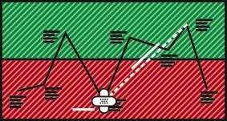
ACTION.
GIFT.
Circle the band-aids and write beside them: „Yes, for me!“

Slide 22
IMPORTANT FOR YOUR FURTHER JOURNEY.
Absorb God´s Word, the Bible, daily for the Bible is God´s love-letter to you.
Share community with other Christians (both joy and sorrow), for we aren´t made to live this life alone.
Speak about your new relationship with God, your heavenly father, with others, for they also need Jesus Christ as their Lord and Savior!

Slide 23
WHAT IDEA WAS
ESPECIALLY
IMPORTANT TO
YOU TODAY?

Slide 24
GOD BLESS YOU!

Slide 25
www.mylifeworkshop.com
MyLife is a workshop by Dr. Dietrich Schindler
©2015
Kommunikative Gestaltung www.lumen-design.de
Bildnachweis: suze, forbfruit – photocase.de
Rembrandt van Rijn

