Slide 1

WELCOME!

Slide 2
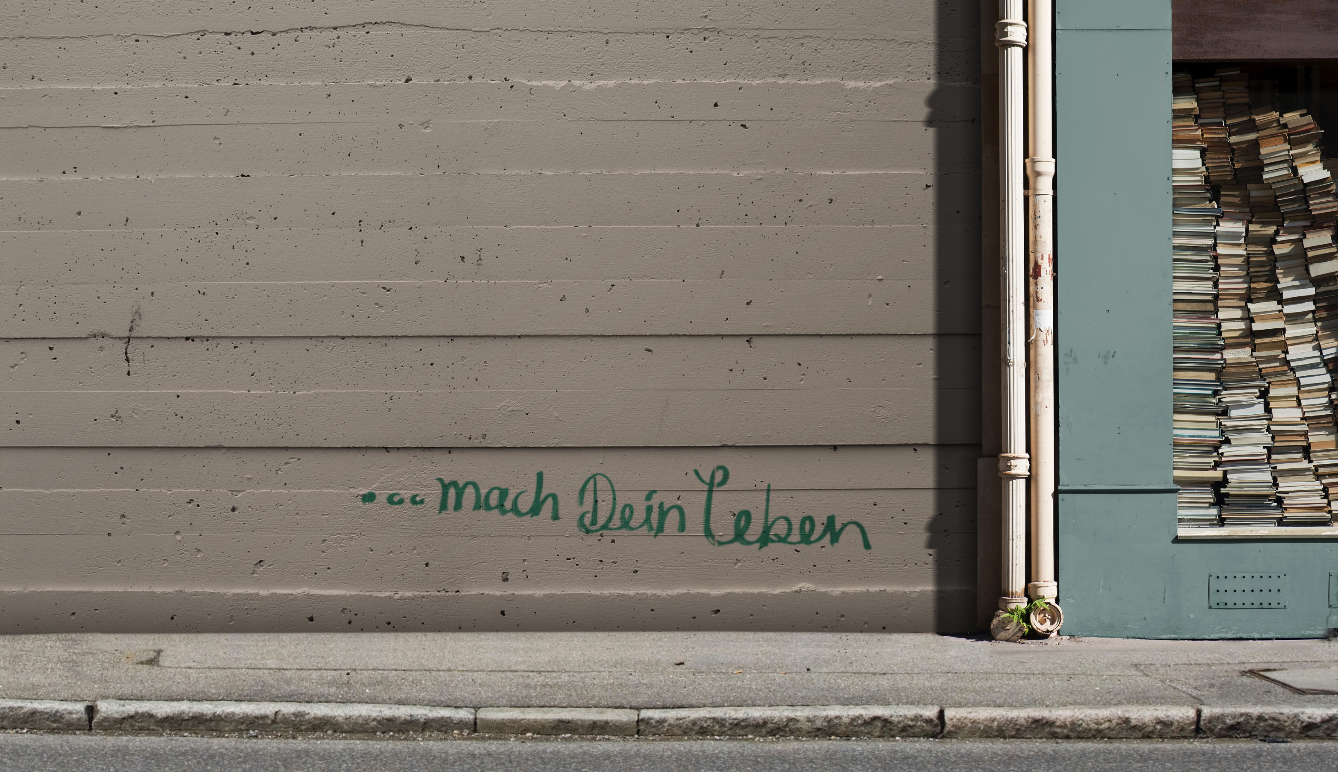

REMINDER:
WHAT ARE WE EXPECTING?
Continuous discussion
Every part closes with a challenge
You will complete your personal MyLife-Map
You will come to new conclusions about you life
Important: Everything is treated confidentially!

Slide 3
FLASHBACK.
We've recognized our uniqueness in the experiences with people and events who have shaped our lives, both positively and painfully.
From these ”imprints“ we have deduced personal values and principles.

Slide 4
WHICH VALUES
DID YOU FIND
ON YOUR
MYLIFE-MAP?

Slide 5
SECOND SESSION
BOOK

Slide 6
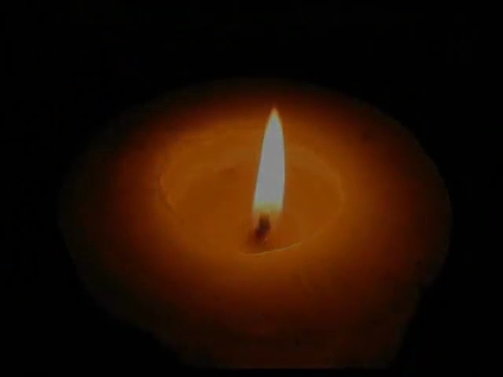

Slide 7
IMAGINE YOUR LIFE AS A BOOK

Slide 8
ACTION.
READ.
Read your MyLife-Map. Imagine your life would be the plot of a book.
TITLE.
What title would you give your book? Write down this title on the top of your MyLife-Map.
SHARE.
„A lot of fun “
„The secret of success“
„First time“
„Luck“
„A hard way “
„Love on sideways“
„Attantion, here I come!“
„Mama macht’s schon“
„No-perspective!“
„Leave me alone!“

Slide 9
ACTION.
SHARE.
Share the results of your MyLife-Map in your small group.
CHAPTERS.
Give each time period a chapter title that fits to the title of your book.
SHARE.
Describe your chapters to those in your group.

Slide 10
EXCHANGE:
HAVE YOU LIVED
THE GOOD LIFE
UP TILL NOW?

Slide 11
For you created my inmost being;
you knit me together in my mother’s womb.
I praise you because I am fearfully and
wonderfully made; your works are wonderful,
I know that full well.
My frame was not hidden from you
when I was made in the secret place,
when I was woven together in the depths
of the earth.
Your eyes saw my unformed body;
all the days ordained for me were written
in your book before one of them came to be.
Psalm 139:13-16

Slide 12
HOMEWORK.
THE GOOD LIFE.
Talk to someone you know well about this question, ”What is the good life?“
YOUR LIFE STORY.
On the basis of your life story – your book – are you living a good life?
PSALM 139.
Read Psalm 139:13-16 every morning and medidate on it.

Slide 13
WHAT IDEA WAS
ESPECIALLY
IMPORTANT TO
YOU TODAY?

Slide 14
A NEW VIEW.
We are moving forward! Everyone outlined their life story.
Next week we will deal with your future.
How will you plan to live the rest of your life?

Slide 15
SEE YOU NEXT TIME!

Slide 16
www.mylifeworkshop.com
MyLife is a workshop by Dr. Dietrich Schindler
©2015
Design: www.lumen-design.de
Bildnachweis: HerrSpecht, .marqs – photocase.de

